Slide 1
Support Vector Machine

Slide 2
Support Vector Machine (SVM)
A classifier derived from statistical learning theory by Vapnik, et al. in 1992
SVM became famous when, using images as input, it gave accuracy comparable to neural-network with hand-designed features
SVM is widely used in object detection & recognition, content-based image retrieval, text recognition, biometrics, speech recognition, etc.

Slide 3
Support Vector Machine (SVM)
SVM are supervised learning models with associated learning algorithms that analyze data used for classification and regression analysis
Steps:
  Given a set of training examples, each marked/labeled as one of two categories
  SVM training algorithm builds a model
  The model assigns new unseen data into one of the two categories

Slide 4
Support Vector Machine (SVM)
SVM uses nonlinear mapping to transfer original training data into a higher dimension.
Within the new dimensions it searches for the linear optimal separating hyperplane (decision boundary) for separating two classes.
SVM finds the hyperplane using support vectors and margins (defined by support vector)

Slide 5
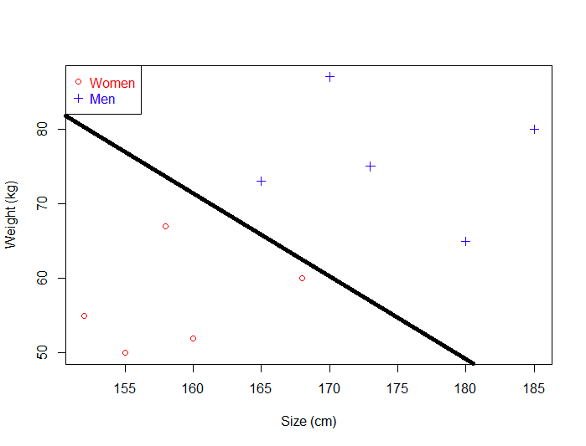
Support Vector Machine (SVM)
A line that seprates the data points are called as hyperplanes.
An hyperplane is a generalization of a plane.
one dimension : an hyperplane is called a point
Two dimensions :it is a line
Three dimensions: it is a plane
More dimensions you can call it an hyperplane

Slide 6
Discriminant Function
The classifier is said to assign a feature vector x to class w_{i} if
g _{i} ( x ) > g _{j} ( x ) for all j ≠ i
For two-category case, g ( x ) ≡ g ₁ ( x ) − g ₂ ( x )

Slide 7
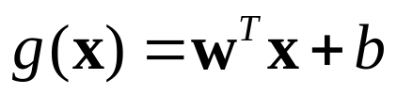
Discriminant Function
It can be arbitrary functions of x, such as:
Nearest
Neighbor
Decision
Tree
Linear
Functions
Nonlinear
Functions

Slide 8
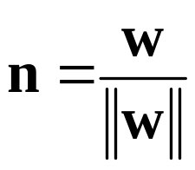
Linear Discriminant Function
g(x) is a linear function:
x₂
w^{T} x + b > 0
A hyper-plane in the feature space
w^{T} x + b = 0
n
(Unit-length) normal vector of the hyper-plane:
w^{T} x + b < 0
x₁

Slide 9
Linear Discriminant Function
denotes +1
denotes -1
How would you classify these points using a linear discriminant function in order to minimize the error rate?
x₂
Infinite number of answers!
x₁

Slide 10
Linear Discriminant Function
denotes +1
denotes -1
How would you classify these points using a linear discriminant function in order to minimize the error rate?
x₂
Infinite number of answers!
x₁

Slide 11
Linear Discriminant Function
denotes +1
denotes -1
How would you classify these points using a linear discriminant function in order to minimize the error rate?
x₂
Infinite number of answers!
x₁

Slide 12
Linear Discriminant Function
denotes +1
denotes -1
How would you classify these points using a linear discriminant function in order to minimize the error rate?
x₂
Infinite number of answers!
Which one is the best?
x₁

Slide 13
Large Margin Linear Classifier
denotes +1
denotes -1
The linear discriminant function (classifier) with the maximum margin is the best.
SVM approaches by searching for the maximum marginal hyperplane.
Margin is defined as the width that the boundary could be incremented by hitting a data point
Why it is the best?
Robust to outliners and thus strong generalization ability
x₂
Margin
“safe zone”
x₁

Slide 14
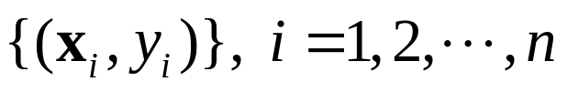
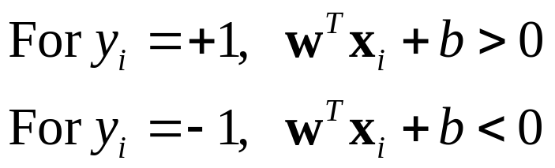
Large Margin Linear Classifier
denotes +1
denotes -1
Given a set of data points:
x₂
, where
With a scale transformation on both w and b, the above is equivalent to
For y_{i} = + 1, w^{T} x _{i} + b ≥ 1
For y_{i} = − 1, w^{T} x _{i} + b ≤ − 1
x₁

Slide 15
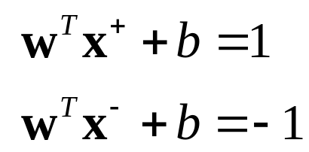
M = ( x⁺ − x⁻ ) ⋅ w/||w||= 2/||w||
Large Margin Linear Classifier
denotes +1
denotes -1
We know that
x₂
Margin
x⁺
w^{T} x + b = 1
x⁺
w^{T} x + b = 0
w^{T} x + b = -1
The margin width is:
n
M = ( x⁺ − x⁻ ) ⋅ n
x⁻
Any datapoints that hit the hyperplane are called as support vectors
The distance from the seprating hyperplane to any point is 1/||w||
The maximal margin is 2/||w||
Support Vectors
x₁

Slide 16
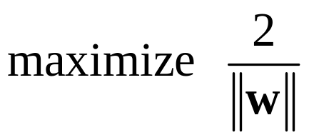
Large Margin Linear Classifier
denotes +1
denotes -1
Formulation:
x₂
Margin
x⁺
w^{T} x + b = 1
such that
x⁺
w^{T} x + b = 0
w^{T} x + b = -1
For y_{i} = + 1, w^{T} x _{i} + b ≥ 1
For y_{i} = − 1, w^{T} x _{i} + b ≤ − 1
n
x⁻
x₁

Slide 17
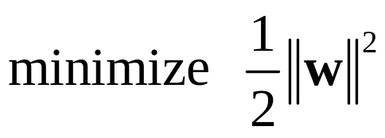
Large Margin Linear Classifier
denotes +1
denotes -1
Formulation:
x₂
Margin
x⁺
w^{T} x + b = 1
such that
x⁺
w^{T} x + b = 0
w^{T} x + b = -1
For y_{i} = + 1, w^{T} x _{i} + b ≥ 1
For y_{i} = − 1, w^{T} x _{i} + b ≤ − 1
n
x⁻
x₁

Slide 18
Large Margin Linear Classifier
denotes +1
denotes -1
Formulation:
x₂
Margin
x⁺
w^{T} x + b = 1
such that
x⁺
w^{T} x + b = 0
w^{T} x + b = -1
y_{i} (w^{T} x _{i} + b )≥ 1
n
x⁻
x₁

Slide 19
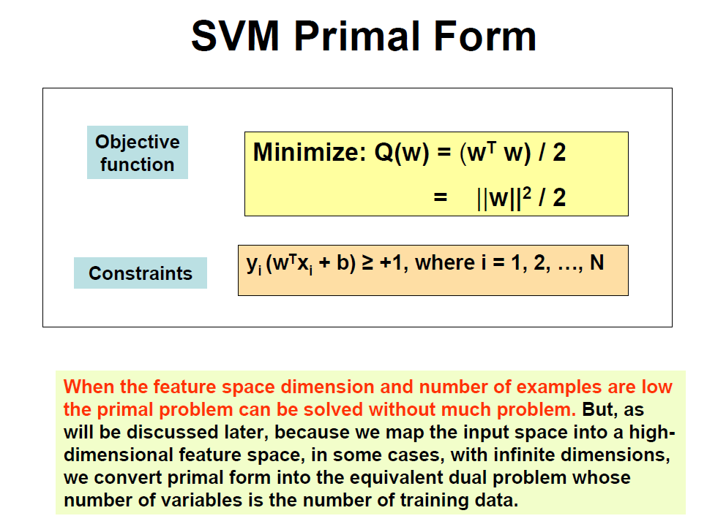

Slide 20
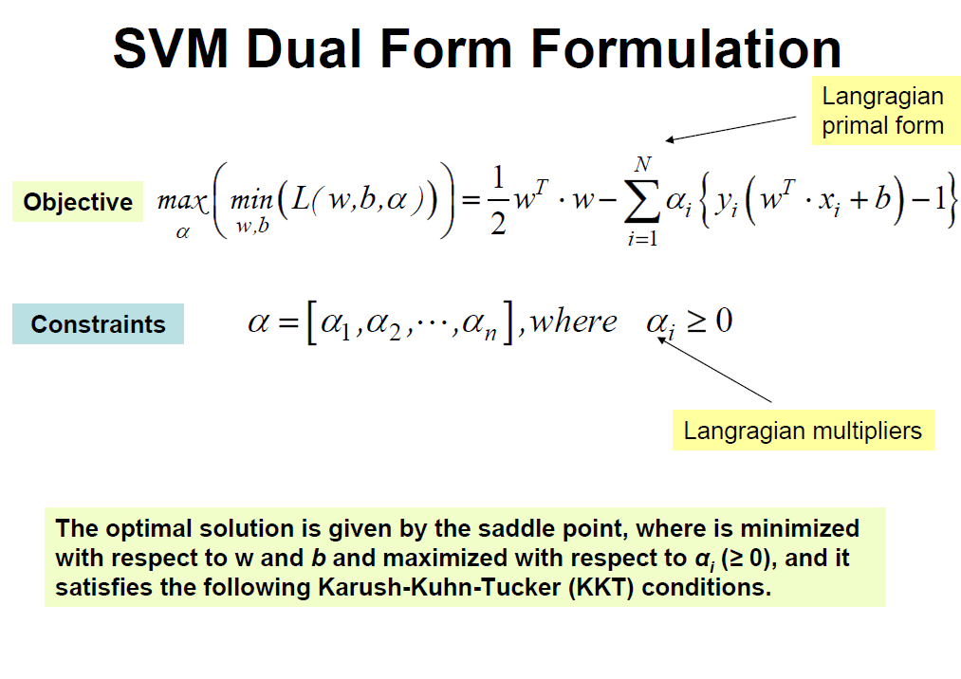
Thus the task is to find an optimum of the primal objective function:

Slide 21
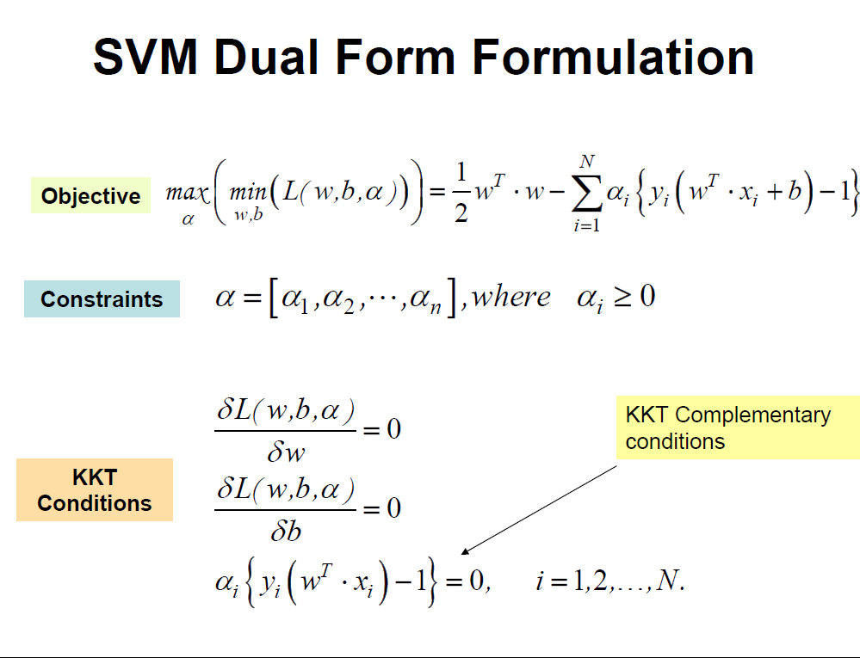

Slide 22
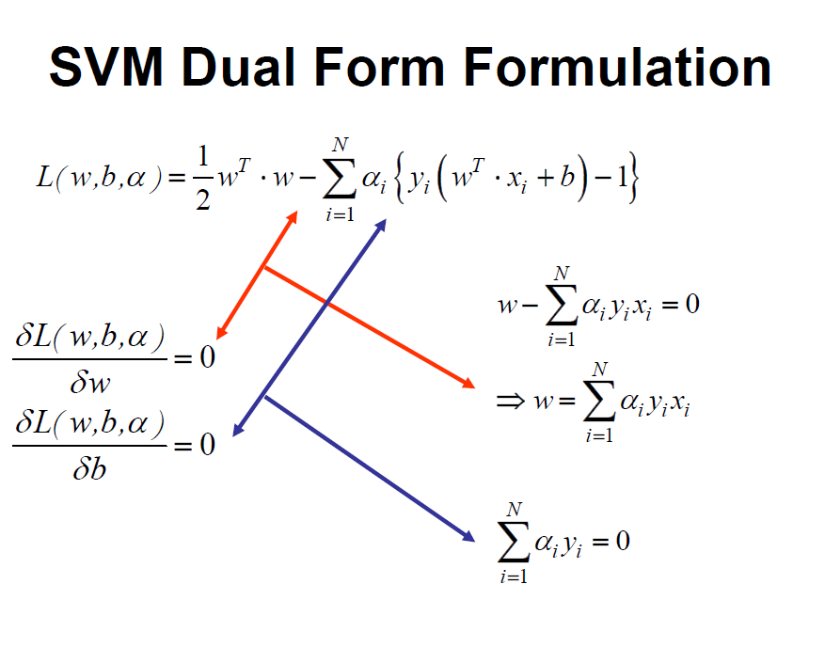

Slide 23
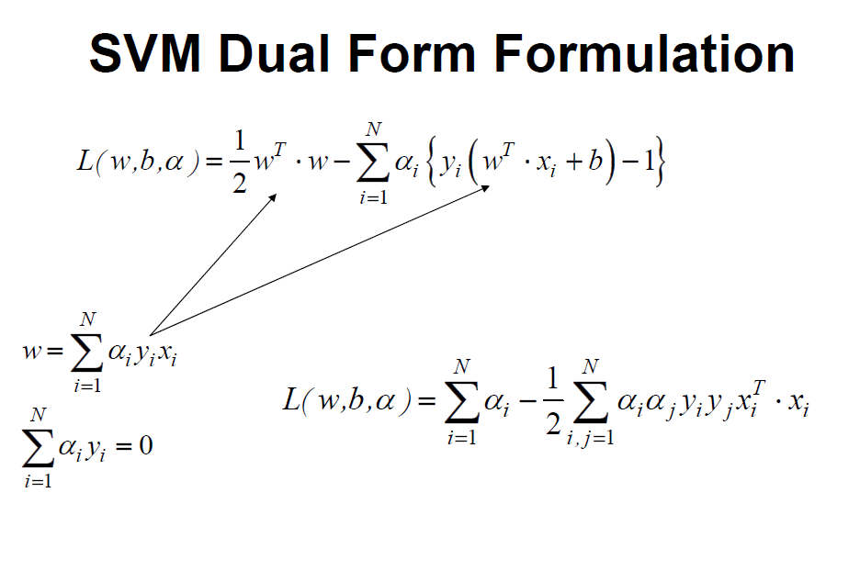

Slide 24
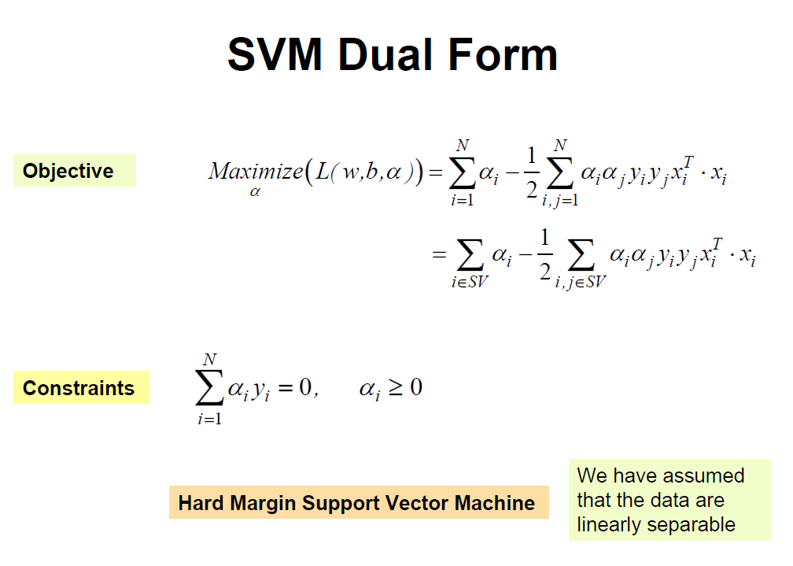

Slide 25
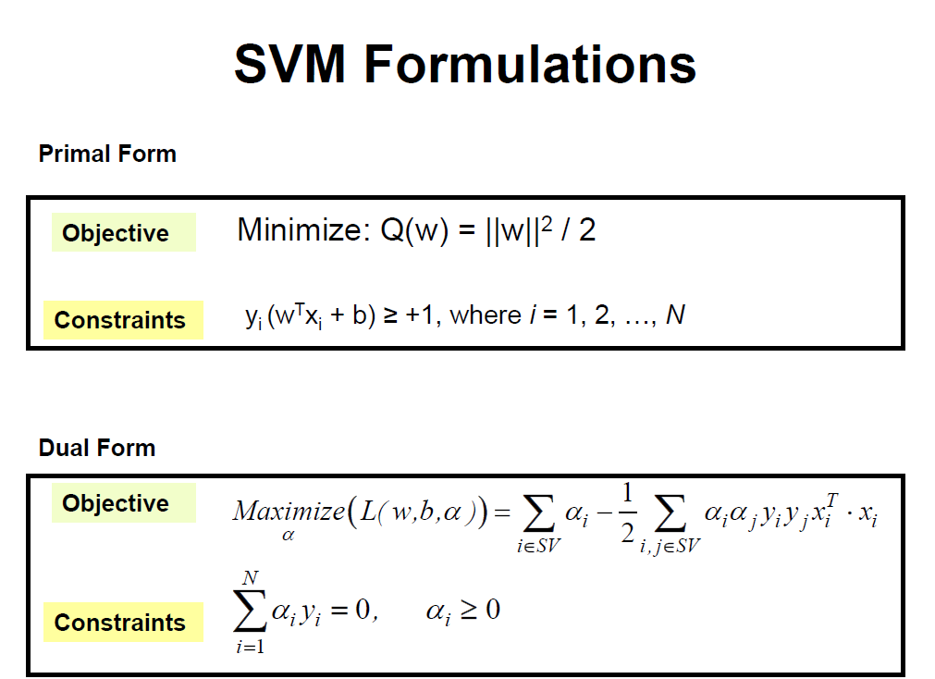

Slide 26
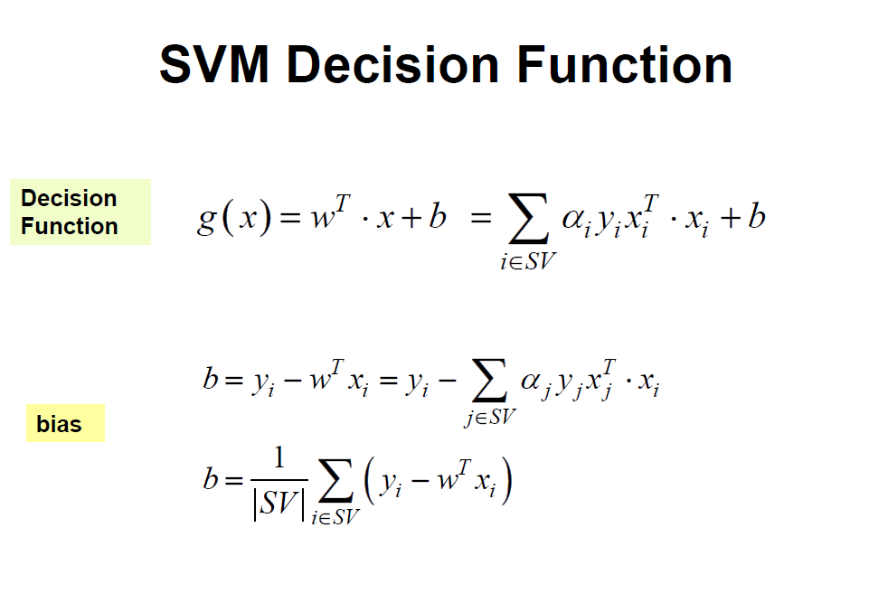

Slide 27
d(X^{T})= sign(∑y_{i} α_{i} X_{i} X^{T} + b₀)
Where y_{i} is the class label of support vectors X_{i} , X^{T} is the test tuple α_{i} and b₀ are the numeric parameters that were determined by the optimization
For linerarly separable problem the support vectors are a subset of the training tuples.
Given a test tuple we plug it into the above equation and check the sign of the result.
If sign is positive then the X^{T} falls above the MMH and so svm predicts SVM belongs to class +1 else class -1.

Slide 28


Large Margin Linear Classifier
denotes +1
denotes -1
What if data is not linear separable? (noisy data, outliers, etc.)
x₂
Slack variables ξ_{i} can be added to allow mis-classification of difficult or noisy data points
w^{T} x + b = 1
w^{T} x + b = 0
w^{T} x + b = -1
x₁

